Slide 1
Posidonia Sea Tourism Forum2023
Socioeconomic Impact of Cruise οn Thessaloniki
Preliminary results of a Thessaloniki Port Authority & Thessaloniki Tourism Organisation study
Thanos Pallis
Department of Maritime Studies
University of Piraeus
Contributing to a better understanding of the benefits of cruising for the local community.

Slide 2
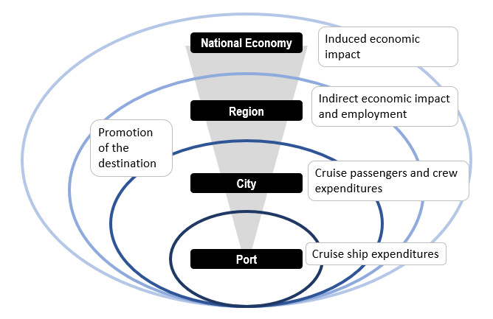
The Scope
Estimation of the socio-economic impact of cruise tourism in the Metropolitan area of Thessaloniki:
Proposals for sustainable cruise development
Communicate to/with local communities on the benefits of cruising
Identify how to increase the added value
Contributing to a better understanding of the benefits of cruising for the local community.

Slide 3
The Method
To identify:
Measuring:
Direct Benefits
Value Added
1
1
Cruise Lines expenditures
Indirect Benefits
2
Cruise Pax expenditures
Employment
Induced Benefits
2
3
Crew members expenditures
But also:
Over an entire cruise season
Type of Activity
Spatial Dimension
Pax
Profile
Pax / Crew
Assessment
Contributing to a better understanding of the benefits of cruising for the local community.

Slide 4
The Cruise year (Nov 22 - Oct 23)
Our Sample
(Nov 22 – April 23)
% of as of the cruise season already measured
Cruise Calls
68
Pax Capacity (total)
79.151
Crew Members
32.031
Pax Capacity (average)
1.164
Crew Members (average)
471
Contributing to a better understanding of the benefits of cruising for the local community.
Notes:
3

Slide 5
Our sample (Nov 22 – April 23)
13 Cruise calls
Shipping Agents
55% occupancy
439 Cruise Pax
Shorex Agents
5,3% of arrivals
134 Crew members
Port dues
Entrance fees
Berthing fees
Embarkation/ Disembarkation
Transit Cruise Passengers
ISPS Code charges (pax)
Fuel Waste and Garbage
Water Supply
In
Notes:
3

Slide 6
Passengers Profile
Number of cruises taken
First time in Greece or Thessaloniki
n = 439 / collection is on-going

Slide 7
Pax expenditures
When in town
The average expenditure per passenger is
€54,5
Based on our (winter) sample
The shore excursion:
The average cost of shore excursions (shorex) is
€98,9
n = 439 / collection is on-going
A % of this cost remains in the local economy as revenue of the shorex companies
Important note for the findings:
Occupancy rate to increase as this has been “ the winter period”
Spending to increase due to more favorable conditions
The average expenditure per passenger on excursion is €15,1

Slide 8
Pax expenditures (when in town)
Distribution of Expenses at the destination - €/pax
The average expenditure per passenger is
€54,5
Based on our (winter) cruise sample
Contributing to a better understanding of the benefits of cruising for the local community.

Slide 9
Pax expenditures (at excursion)
Distribution of expenses at the excursion - €/pax
Average expenditure per passenger on excursion: €15,1
Average cost of shore excursions: €98,9
A percentage of this cost remains at the local economy as revenue of the shorex companies
Based on our (winter) cruise sample
Contributing to a better understanding of the benefits of cruising for the local community.

Slide 10
Crew expenditures
Average expenditure per crew member: €105,4
Distribution of crew expenses at destination - - €/pax
Based on our (winter) cruise sample
Contributing to a better understanding of the benefits of cruising for the local community.

Slide 11
Τhe impact of winter cruising alone
Value Added
Direct Impact: €798.815
Indirect Impact: €533.608
Total Economic Impact: €1.332.423
Employment
(full-time maintained jobs)
Direct Impact: 24 FTE jobs
Indirect Impact: 11 FTE jobs
Total Employment: 35 FTE jobs
Method for calculating the indirect economic impact: the Leontief Inverse Matrix table for the Greek economy. (The multiplier is 1,668)

Slide 12
An initial full cruise year estimation
Value Added
Total Direct Impact | 5.133.571 €
Cruise Passengers Crew members Cruise Vessels – Port Revenues Cruise Vessels Expenditures Shipping Agents Shorex Agents
Indirect Economic Impact | 3.429.225 €
Total Economic Impact | 8.562.796 €
Based on our winter sample
Cruise vessel occupancy rate: 70%
Cruise passengers staying onboard: 20%
Disembarked passengers taking a shore excursion: 35%
Crew disembarking at destination: 20%
Employment
Direct Jobs = 25 FTEs jobs
Indirect Jobs = 68 FTEs
Total Jobs = 93 FTEs
Method for calculating the indirect economic impact: the Leontief Inverse Matrix table for the Greek economy.

Slide 13
An initial full cruise year estimation
Value Added
Total Direct Impact | 6.487.882 €
Cruise Passengers Crew members Cruise Vessels – Port Revenues Cruise Vessels Expenditures Shipping Agents Shorex Agents
Indirect Economic Impact | 4.333.905 €
Total Economic Impact | 10.821.787 €
The expected scenario
Cruise vessel occupancy rate: 100%
Cruise passengers staying onboard: 10%
Disembarked passengers taking a shore excursion: 35%
Crew disembarking at destination: 20%
Employment
Direct Jobs = 25 FTEs jobs
Indirect Jobs = 86 FTEs jobs
Total Jobs = 111 FTEs jobs
Method for calculating the indirect economic impact: the Leontief Inverse Matrix table for the Greek economy.

Slide 14
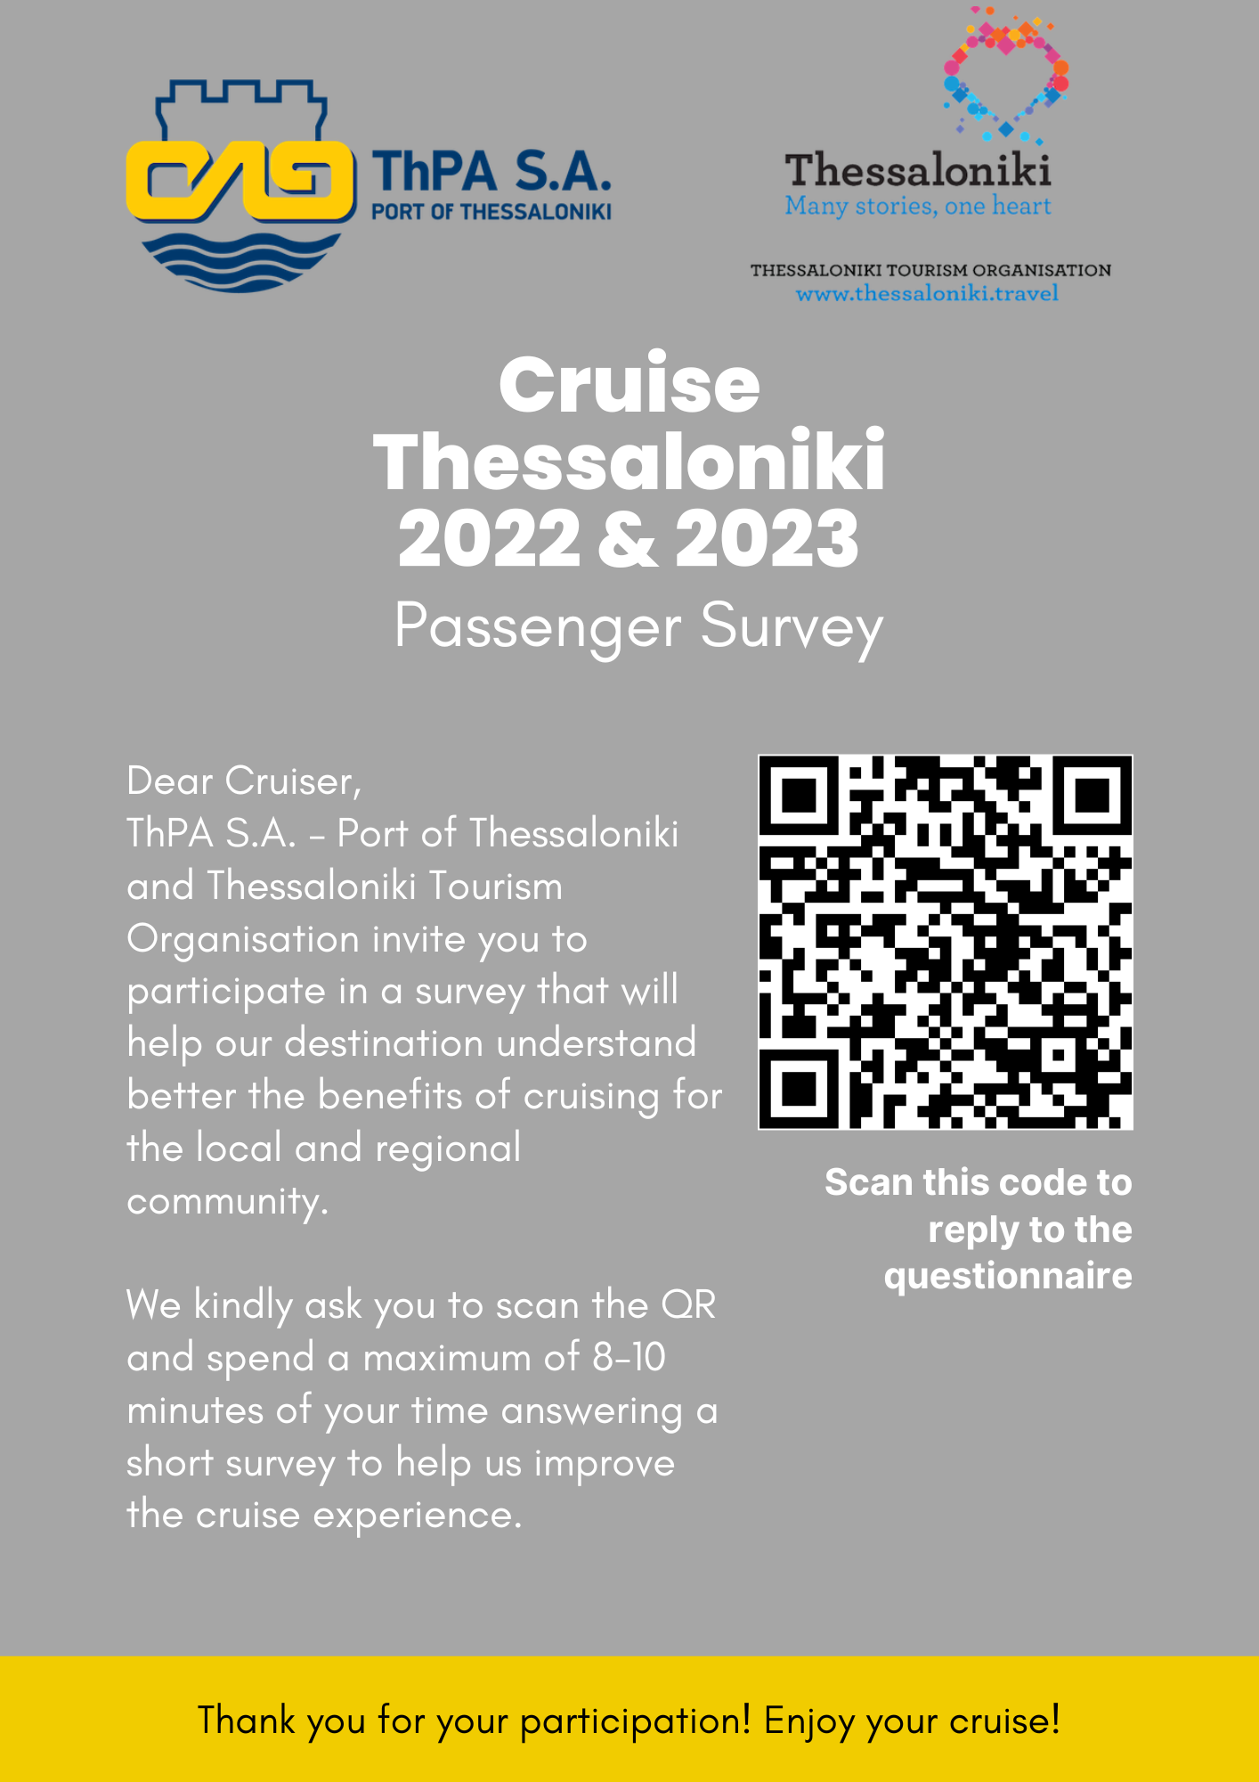
Word of mouth: How likely is it to recommend the destination?
90,1% will recommend the destination
Contributing to a better understanding of the benefits of cruising for the local community.

Slide 15
Posidonia Sea Tourism Forum2023
Contributing to a better understanding of the benefits of cruising for the local community.
Thanos Pallis
Department of Maritime Studies
University of Piraeus

